Slide 1
Image and Video Processing

Slide 2
3.11 Video Enhancement and Restoration

Slide 3
1. Introduction
Video enhancement and restoration has always been important, not only to improve the visual quality but also to increase the performance of subsequent tasks such as analysis and interpretation.
applications
one encounters in astronomy, forensic sciences, and medical imaging
preserving motion pictures and videotapes recorded over the last century : reusing old film and video material

Slide 4
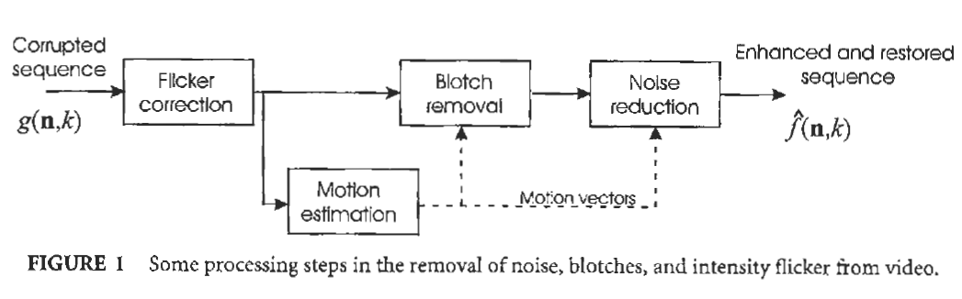
1. Introduction

Slide 5
2. Spatiotemporal Noise Filtering
the ideal uncorrupted image sequence f(n, k).
The recorded image sequence g(n, k) corrupted by noise w(n, k) is then given by
(1)
where n = (n1, n2) refers to the spatial coordinates and k to the frame number in the image sequence.

Slide 6
2. Spatiotemporal Noise Filtering
2.1 Linear Filters
2.2 Order-Statistic Filters
2.3 Multiresolution Filters

Slide 7
2.1 Linear Filters
Temporally Averaging Filters
Temporally Recursive Filters

Slide 8
2.1 Linear Filters
Temporally Averaging Filters
the restored image sequence is obtained by
(2)
Here h(l) are the temporal filter coefficients used to weight 2K+l consecutive frames.

Slide 9

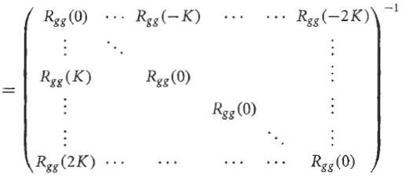
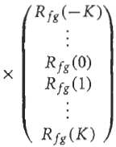
2.1 Linear Filters
Temporally Averaging Filters
the filter coefficients can be optimized in a minimum mean-squared error fashion,
yielding the well-known temporal Wiener filtering solution:

Slide 10
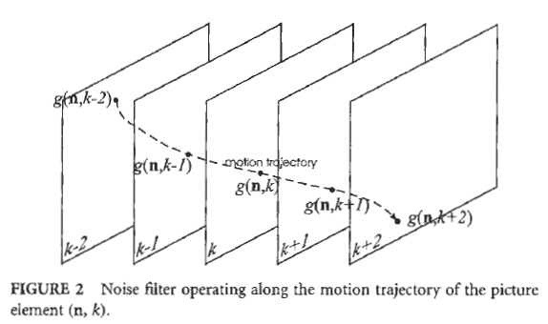
2.1 Linear Filters
Temporally Averaging Filters
The motion artifacts can greatly be reduced by operating the
filter, along the picture elements (pixels) that lie on
the same motion trajectory .

Slide 11

2.1 Linear Filters
Temporally Averaging Filters
Equation (2) then becomes a motion-compensated temporal filter.
Here $d\left(n;k,l\right)={(d}_{x}\left(n_{1},n_{2};k,l\right),d_{y}(n_{1},n_{2};k,l))$is the motion vector for spatial coordinate $(n_{1},n_{2})$estimated between the frames k and l .

Slide 12
2.1 Linear Filters
Temporally Averaging Filters
Eq. (2) can be extended with a spatial filtering part. The most straightforward extension of Eq. (2) is the following 3-D weighted averaging filter:
Here S is the spatiotemporal support or window of the 3-D filter
(see Fig. 3).

Slide 13
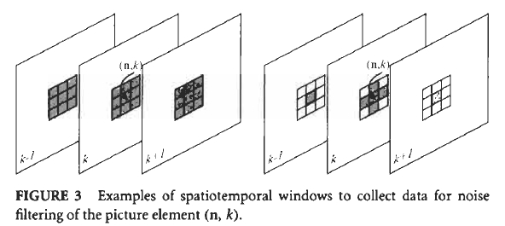
2.1 Linear Filters
Temporally Averaging Filters
Here S is the spatiotemporal support or window of the 3-D filter
(see Fig. 3).

Slide 14
2.1 Linear Filters
Temporally Averaging Filters
Disadvantages with the 3-D Wiener filter:
The requirement that the 3-D autocorrelation function for the original image sequence is known a priori.
The 3-D wide-sense stationarity assumptions, which are virtually never true because of moving objects and scene changes.

Slide 15
2.1 Linear Filters
Temporally Averaging Filters
Simpler ways of choosing the 3-D filter coefficients are usually preferred, one such choice for adaptive filter coefficients is the following:

Slide 16
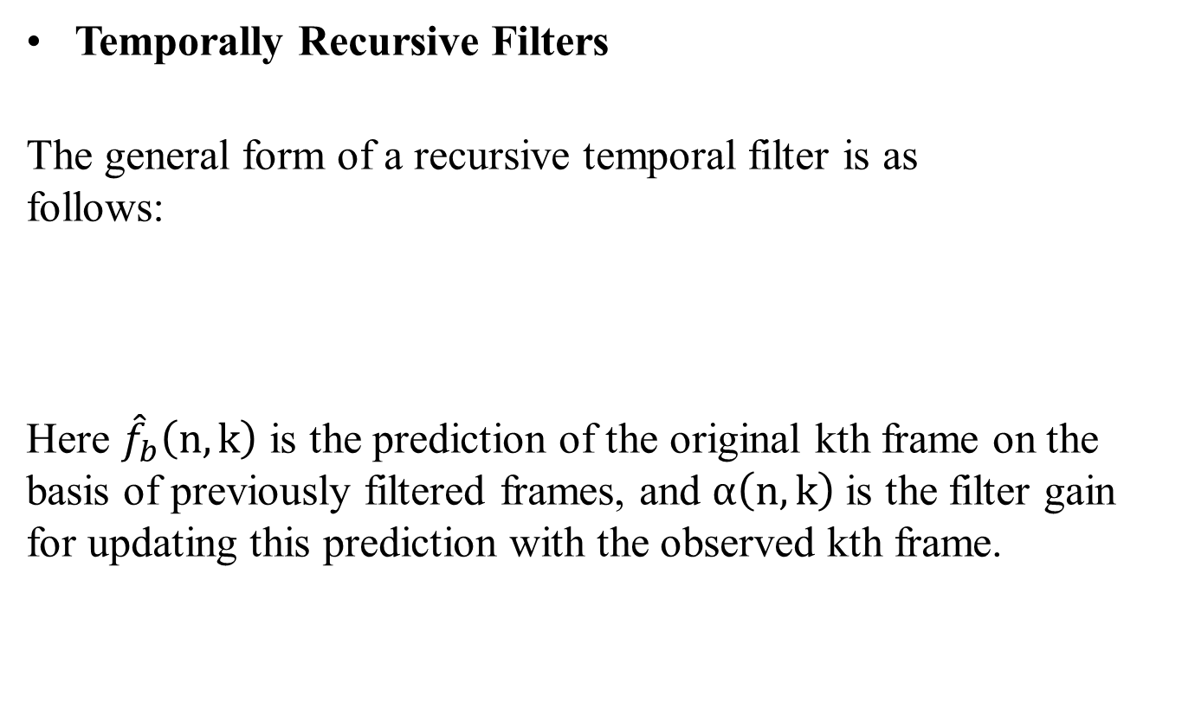
2.1 Linear Filters
Temporally Recursive Filters
The general form of a recursive temporal filter is as
follows:
Here ${\hat{f}}_{b}\left(n,k\right)$ is the prediction of the original kth frame on the basis of previously filtered frames, and $α\left(n,k\right)$is the filter gain for updating this prediction with the observed kth frame.

Slide 17
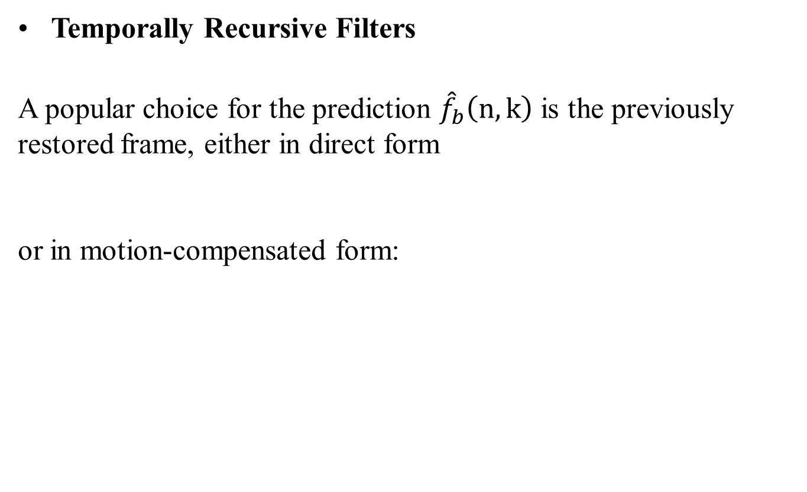
2.1 Linear Filters
Temporally Recursive Filters
A popular choice for the prediction ${\hat{f}}_{b}\left(n,k\right)$is the previously restored frame, either in direct form
or in motion-compensated form:

Slide 18


2.1 Linear Filters
Temporally Recursive Filters
A switching filter is obtained if the gain takes on the values a and 1, depending on the difference between the prediction ${\hat{f}}_{b}\left(n,k\right)$and the actually observed signal value g(n, k):

Slide 19


2.1 Linear Filters
Temporally Recursive Filters
A finer adaptation is obtained if the prediction gain is optimized
to minimize the mean-squared restoration error , yielding
Here is an estimate of the image sequence variance in a local spatiotemporal neighborhood of (n, k).

Slide 20
2.2 Order-Statistic Filters
Order-statistic (OS) filters are nonlinear variants of weighted averaging filters.
The distinction is that in OS filters the observed noisy data, usually taken from a small spatiotemporal window, are ordered before being used.

Slide 21
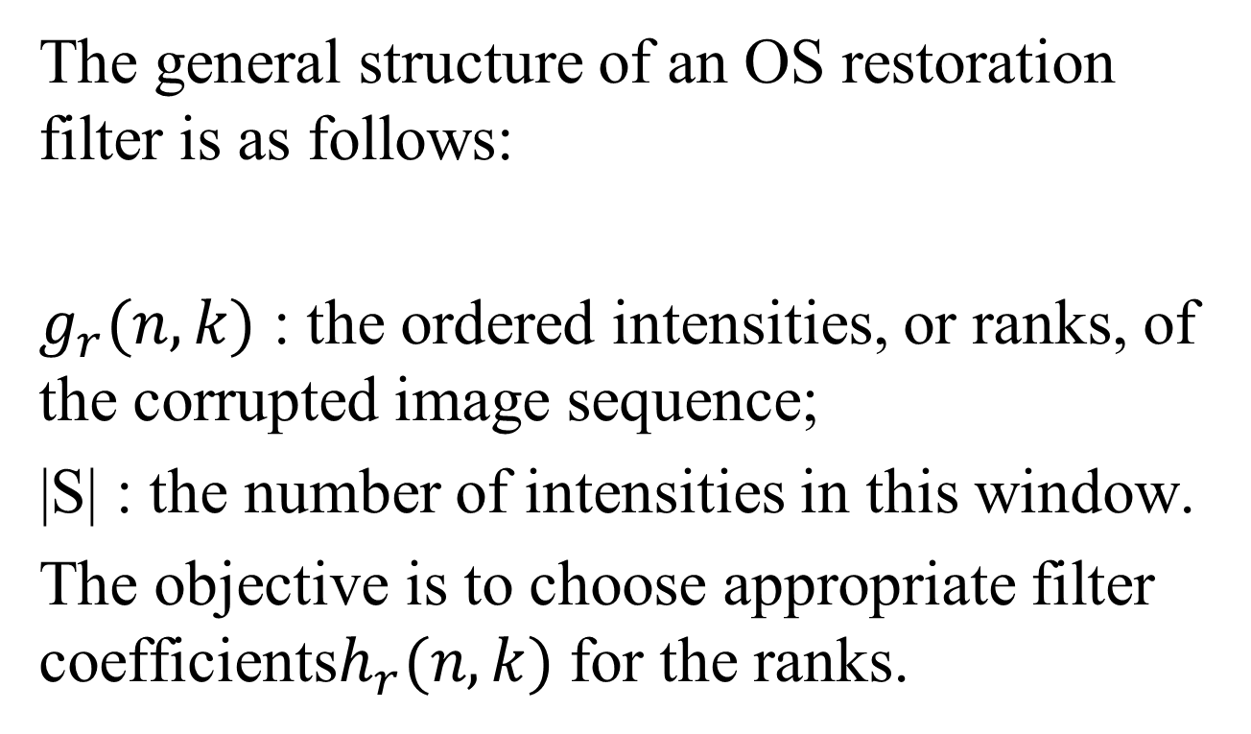
2.2 Order-Statistic Filters
The general structure of an OS restoration filter is as follows:
$g_{r}(n,k)$ : the ordered intensities, or ranks, of the corrupted image sequence;
|S| : the number of intensities in this window.
The objective is to choose appropriate filter coefficients$h_{r}(n,k)$ for the ranks.

Slide 22

2.2 Order-Statistic Filters
The most simple order-statistic filter is a straightforward temporal median, for instance taken over three frames:
the multistage median filter (MMF):

Slide 23
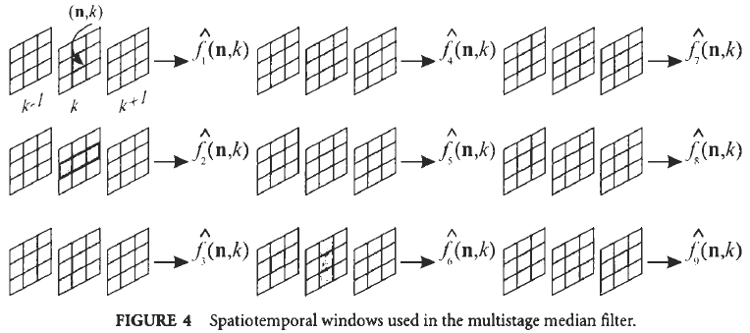
2.2 Order-Statistic Filters
an example of the spatiotemporal supports of the multistage median filter

Slide 24
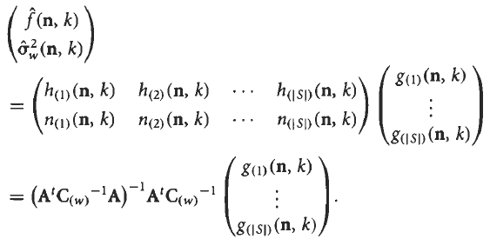
2.2 Order-Statistic Filters
If the coefficients are optimized in the mean-squared error sense, the following general solution for the restored image sequence is obtained :

Slide 25
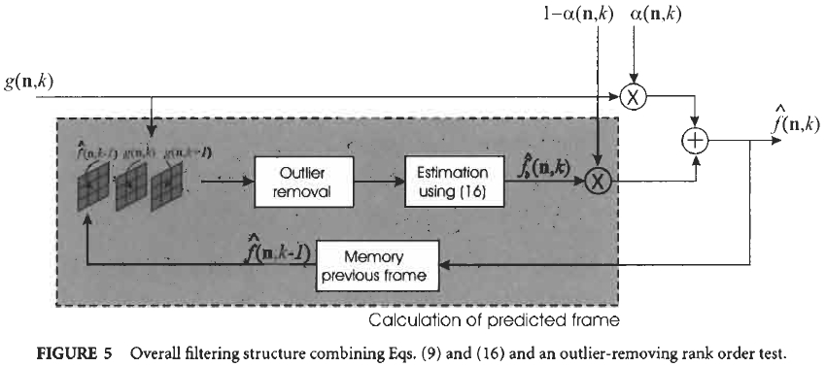
2.2 Order-Statistic Filters
The overall filter structure thus obtained is shown in Fig. 5.

Slide 26
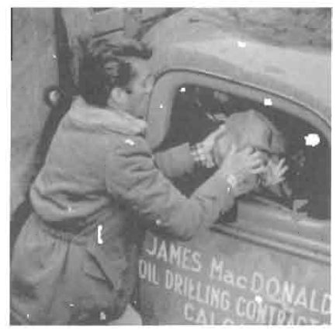
3. Blotch Detection and Removal

Slide 27
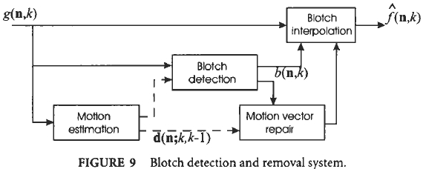
3. Blotch Detection and Removal
A model for blotch is the following:
The overall blotch detection and removal scheme :

Slide 28
3.1 Blotch Detection
three characteristic properties:
blotches are temporally independent and therefore hardly ever occur at the same spatial location in successive frames.
the intensity of a blotch is significantly different from its neighboring uncorrupted intensities.
blotches form coherent regions in a frame, as opposed to, for instance, spatiotemporal shot noise.

Slide 29
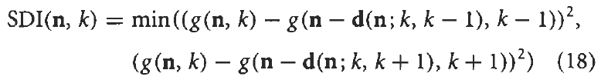

3.1 Blotch Detection
pixel-based blotch detector : the spike-detector index (SDI)
A blotch pixel is detected if SDI(n,k) exceeds a threshold:

Slide 30
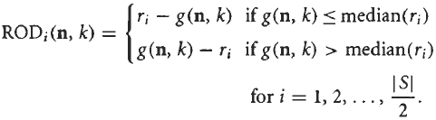
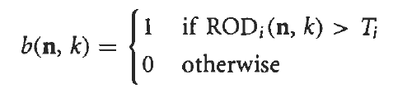
3.1 Blotch Detection
order-statistic-based detector : the rank order difference (ROD) detector
A blotch pixel is detected if any of the rank order differences exceeds a specific threshold Ti:

Slide 31
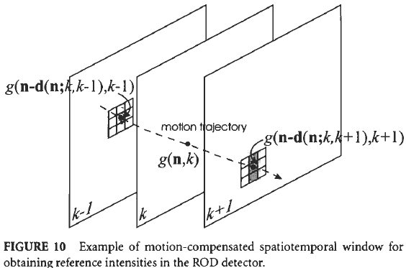
3.1 Blotch Detection

Slide 32
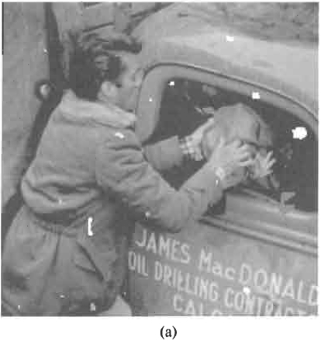
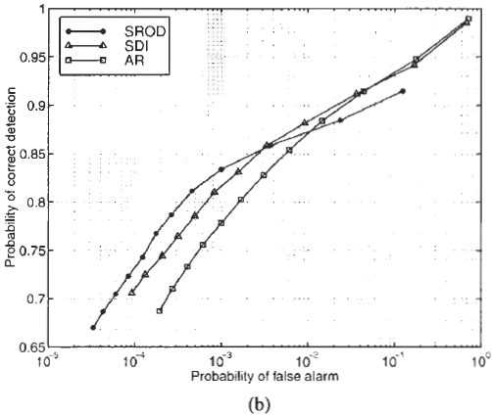
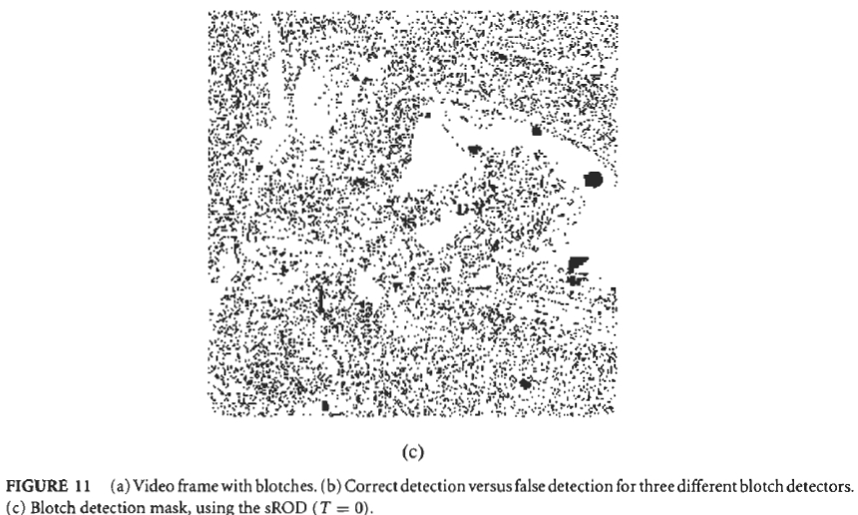
3.1 Blotch Detection

Slide 33
3.1 Blotch Detection
postprocessing the blotch mask in two ways:
removing small blotches
completing partially detected blotches: hysteresis thresholding

Slide 34
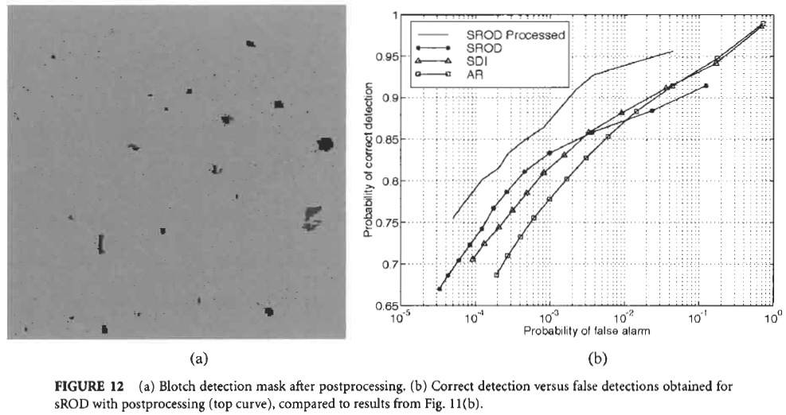
3.1 Blotch Detection

Slide 35
3.2 Motion Vector Repair and Interpolating Corrupted Intensities
Two strategies in recovering motion vectors:
take an average of surrounding motion vectors
validate the corrected motion vectors using intensity information directly neighboring the blotched area

Slide 36
3.2 Motion Vector Repair and Interpolating Corrupted Intensities
In a multistage median interpolation filter, five interpolated results are computed by using the (motion-compensated) spatiotemporal neighborhoods.

Slide 37


3.2 Motion Vector Repair and Interpolating Corrupted Intensities
Each of the five interpolated results is computed as the median over the corresponding neighborhood Si:
The final result is computed as the median over the five intermediate results:

Slide 38
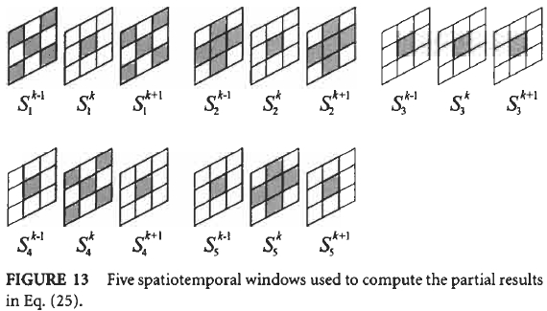
3.2 Motion Vector Repair and Interpolating Corrupted Intensities

Slide 39
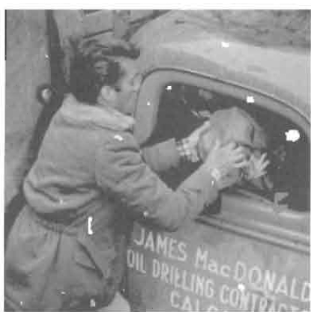
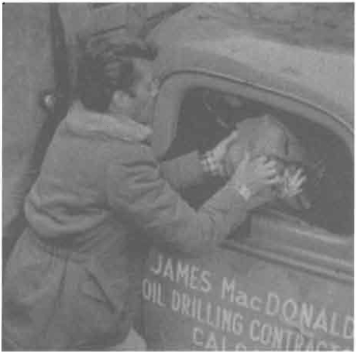
3.2 Motion Vector Repair and Interpolating Corrupted Intensities
Result of the blotch-corrected frame:

Slide 40
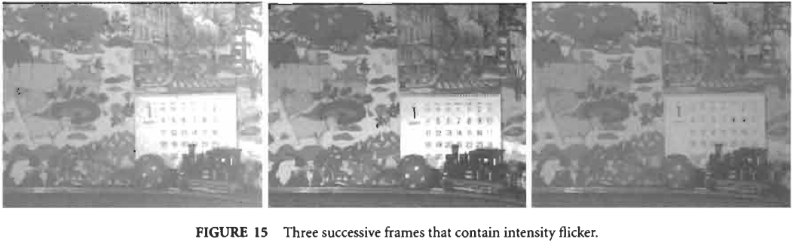
4. Intensity Flicker Correction
Intensity flicker is defined as unnatural temporal fluctuations of frame intensities that do not originate from the original scene.

Slide 41
4. Intensity Flicker Correction
A model describing the intensity flicker:
Here , and are the multiplicative and additive unknown flicker parameters,
is an independent noise term.

Slide 42
4.1 Flicker Parameter Estimation
If the flicker parameters were known, then one could form an estimate of the original intensity from a corrupted intensity by using the following straightforward linear estimator:

Slide 43
In order to obtain estimates for the coefficients
, the mean-squared error between and is minimized, yielding the following optimal solution:

Slide 44
4.1 Flicker Parameter Estimation
If the observed image sequence does not contain any noise, then:

Slide 45
4.1 Flicker Parameter Estimation
In practice, the true values for the intensity-flicker parameters α(n, k) and β(n, k) are unknown and have to be estimated from the corrupted image sequence itself.
Since the flicker parameters are spatially smooth functions, we assume that they are locally constant:
where S_{m} indicates a small frame region.

Slide 46
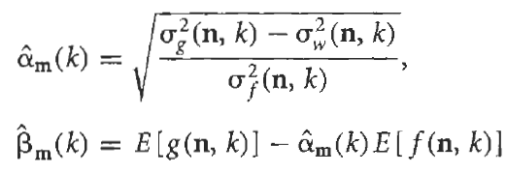
4.1 Flicker Parameter Estimation
By computing the averages and variances of both sides of
one can obtain:

Slide 47
4.2 Estimation on Sequences with Motion
We assume that the image sequence intensities do not change significantly over time previously. Clearly, this is an incorrect assumption if motion occurs.
Because of the intensity flicker this assumption is violated heavily. The only motion that can be estimated with sufficient reliability is global motion such as camera panning or zooming.

Slide 48
4.2 Estimation on Sequences with Motion
There are various approaches for detecting local motion
the detection of large differences between the current and previously (corrected) frame
compare the estimated intensity-flicker parameters to threshold values

Slide 49
4.2 Estimation on Sequences with Motion
For frame regions S, where the flicker parameters could not be estimated reliably from the observed image sequence, the parameters are estimated on the basis of the results in spatially neighboring regions.
For the regions in which the flicker parameters could be estimated, a smoothing post processing step has to be applied to avoid sudden parameter changes that lead to visible artifacts in the corrected image sequence.

Slide 50
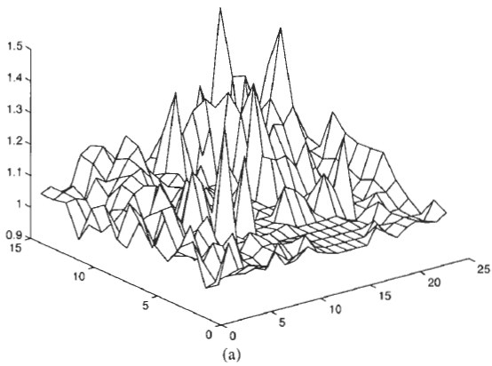
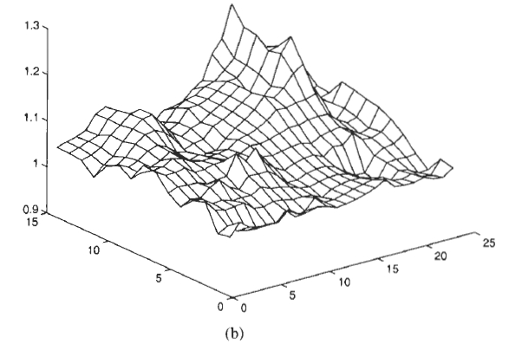

4.2 Estimation on Sequences with Motion

Slide 51
Conclude
This chapter has described methods for enhancing and restoring corrupted video and film sequences. Although the focus has been on noise removal, blotch detection and correction, and flicker removal, the approaches and tools described in this chapter are of a more general nature, and they can be used for developing enhancement and restoration methods for other types of degradation.

